Slide 1
Modeling and Experimenting with Transactive Energy Use-Cases

Slide 2
Detailed Description:
This project aims to develop models of power grid and associated transactive energy distributed energy resources using WebGME modeling environment and build several use-cases for the application of transactive energy mechanisms in demonstrating its feasibility and effectiveness in managing the power demand and supply balance in the presence of intermittent energy generation sources and varying power demands.

Slide 3
TE Six Use Cases
• UC1: Peak Heat Day and Energy Supply;
• UC2: Wind Energy Balancing Reserves;
• UC3: High-Penetration PV and Voltage Control;
• UC4: EVs on the Neighborhood Transformer;
• UC5: Islanded Microgrid Energy Balancing;
• UC6: System Constraint Resulting in Mandatory Curtailment.

Slide 4
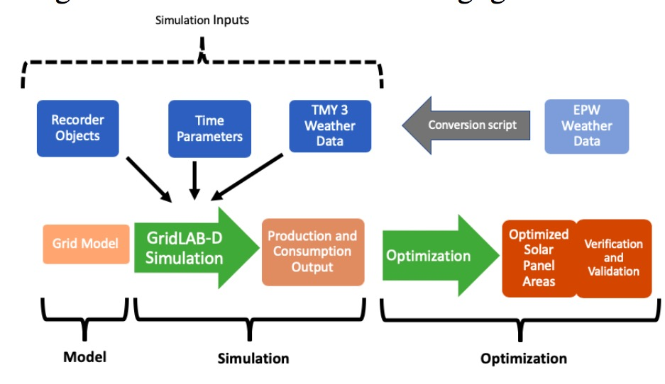
Image Source: Modeling and Optimization of a Longitudinally-Distributed Global Solar Grid
The Workflow of Our Simulation Experiment

